Slide 1
Looking at raw NGS data
O. Harismendy, PhD
BIOM262 – W2017

Slide 2
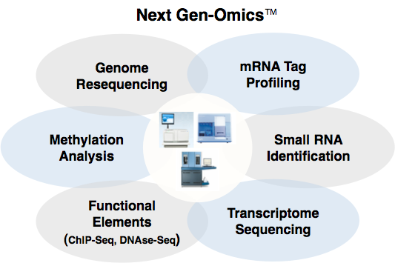
NGS is ubiquitous
Mutations
Structural variations
De novo sequencing
Targeted sequencing
Silenced DNA
Imprinted regions
Novel RNA discovery
Digital transcriptome
New isoforms
Location of proteins on DNA
Level of Occupancy
Sequencing is providing a universal read out for many biological experiments

Slide 3
SEQUENCING BY SYNTHESIS
Illumina Technology

Slide 4
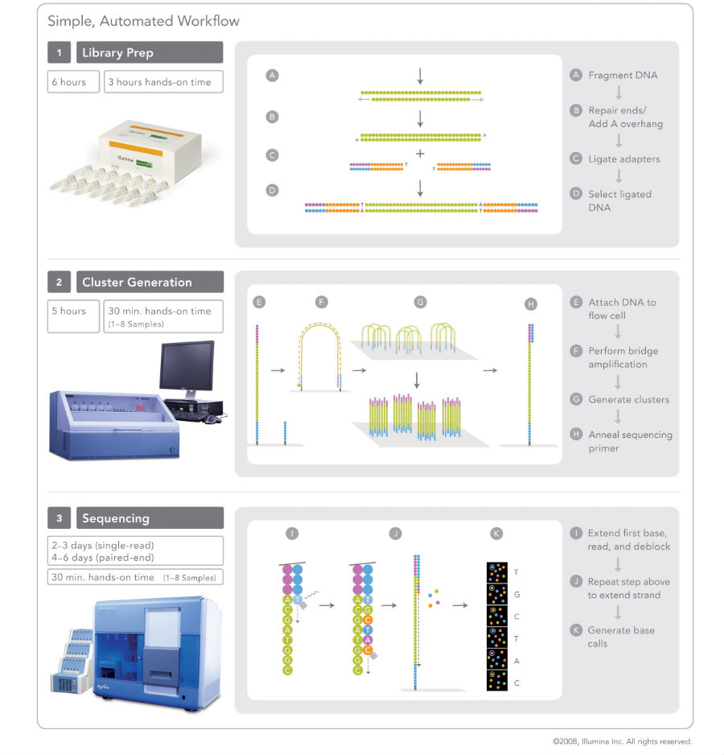
Illumina Technology
Library Preparation (TruSeq)

Slide 5
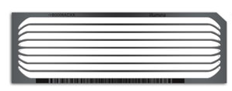
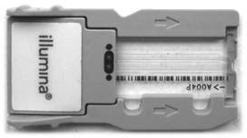
Illumina Technology
Clonal amplification

Slide 6

Illumina Technology
Sequencing by synthesis

Slide 7
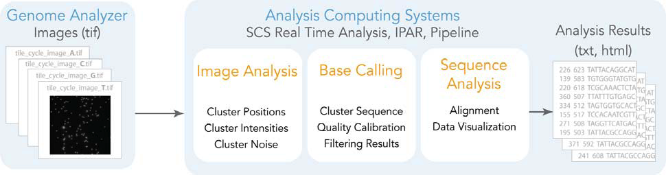
Real Time Analysis

Slide 8
Multi-Step analysis
Quality Control
Read Alignment
Alignment Refinement
Variant Calling
Variant Filtering
Variant Annotation
Visualization
Alignment
Variants

Slide 9
Alignment and Variant Calling Pipeline
Process from HiSeq
Align
Refine
Call Variants
HiSeq BCL files
FASTQ format
Mapped BAM
Cleaned BAM
BWA
Align
GATK
Realign
GATK
Call
Left Align Indels
Filter
Evaluate
CASAVA 1.8
Sort
Reformat
-Unmapped
Samtools
Picard
-Duplicates
GATK
Recalibrate
FASTQ format
Mapped BAM
Cleaned BAM
Filtered VCF

Slide 10
File Sizes
 | Depth | FASTQ.gz | BAM | VCF.gz
Genome | 30x | 100-200Gb | 100-200Gb | 2Gb
Exome (50 Mb) | 120x | 5-10 Gb | 10-30Gb | 3-6Mb
Deep Targeted (150 kb) | 1500x | 300-500Mb | 150Mb | 3-6Mb
Assume 100 bp read length

Slide 11
Instrument QC

Slide 12
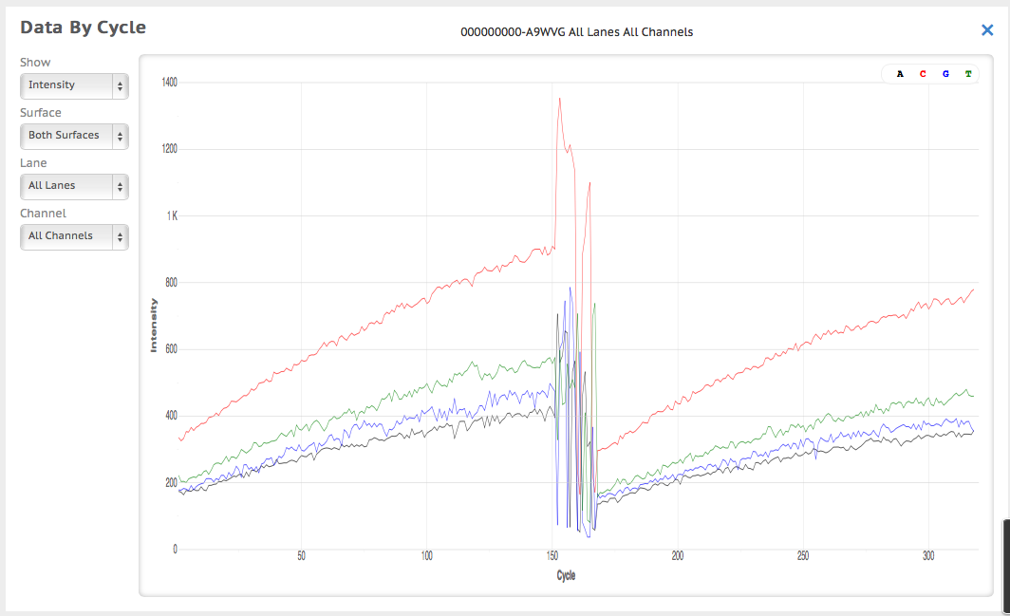
Instrument QC

Slide 13
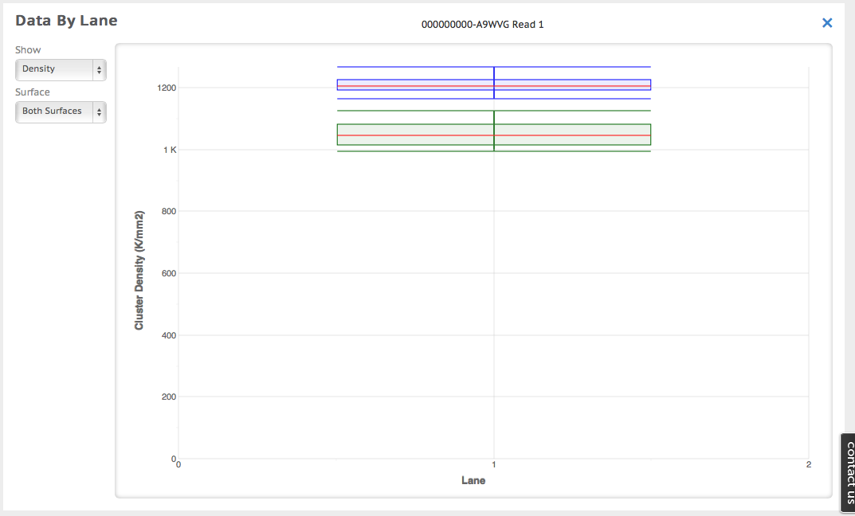
Instrument QC

Slide 14
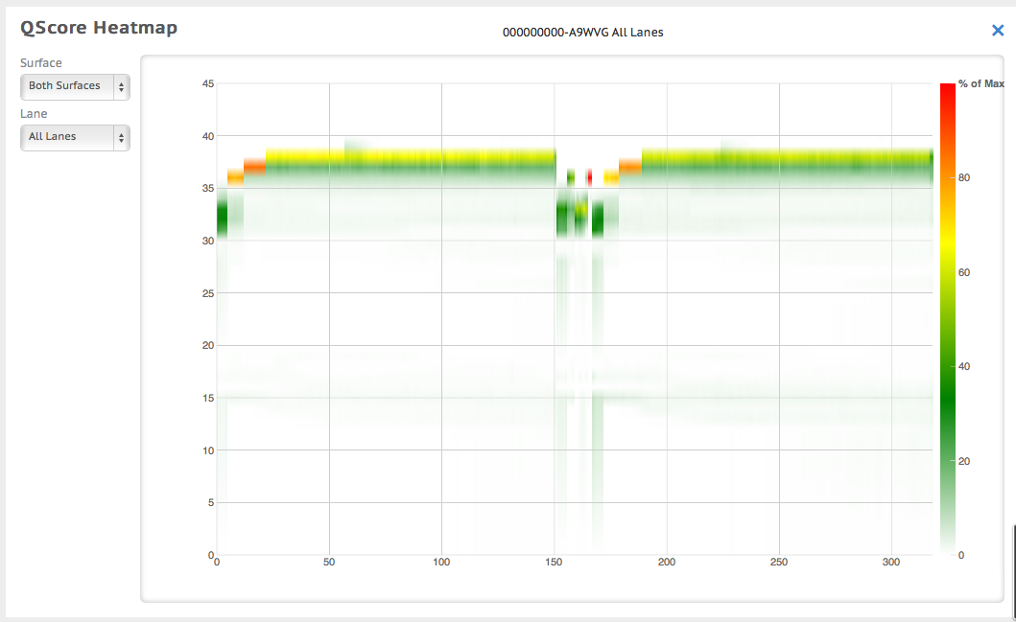
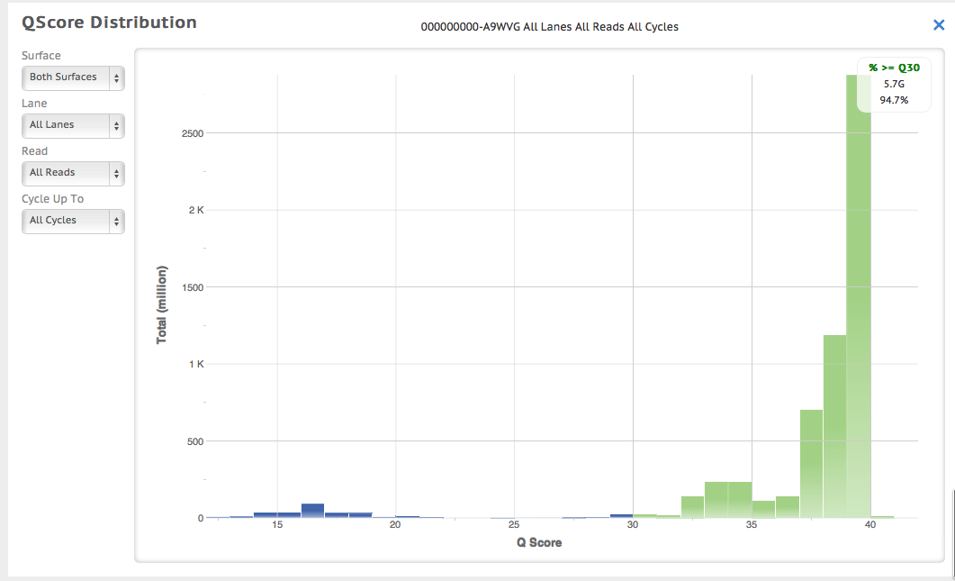
Instrument QC

Slide 15
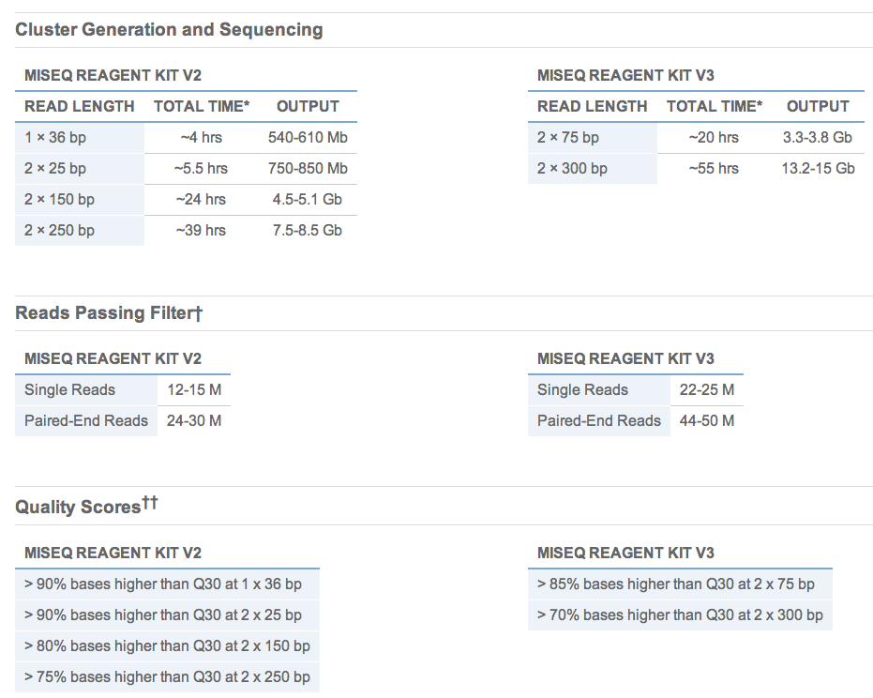
Instrument QC
MiSeq specifications

Slide 16
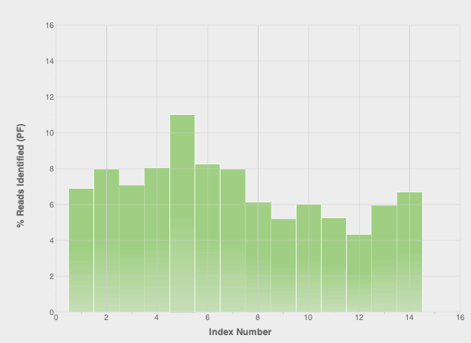
Instrument QC

Slide 17
FASTQ

Slide 18
FASTQ
@IL31_4368:1:1:996:8507/2
TCCCTTACCCCCAAGCTCCATACCCTCCTAATGCCCACACCTCTTACCTTAGGA
+
FFCEFFFEEFFFFFFFEFFEFFFEFCFC<EEFEFFFCEFF<;EEFF=FEE?FCE
@IL31_4368:1:1:996:21421/2
CAAAAACTTTCACTTTACCTGCCGGGTTTCCCAGTTTACATTCCACTGTTTGAC
+
>DBDDB,B9BAA4AAB7BB?7BBB=91;+*@;5<87+*=/*@@?9=73=.7)7*
@IL31_4368:1:1:997:10572/2
GATCTTCTGTGACTGGAAGAAAATGTGTTACATATTACATTTCTGTCCCCATTG
+
E?=EECE<EEEE98EEEEAEEBD??BE@AEAB><EEABCEEDEC<<EBDA=DEE
@IL31_4368:1:1:997:15684/2
CAGCCTCAGATTCAGCATTCTCAAATTCAGCTGCGGCTGAAACAGCAGCAGGAC
+
EEEEDEEE9EAEEDEEEEEEEEEECEEAAEEDEE<CD=D=*BCAC?;CB,<D@,
@IL31_4368:1:1:997:15249/2
AATGTTCTGAAACCTCTGAGAAAGCAAATATTTATTTTAATGAAAAATCCTTAT
+
EDEEC;EEE;EEE?EECE;7AEEEEEE07EECEA;D6D>+EE4E7EEE4;E=EA
@IL31_4368:1:1:997:6273/2
ACATTTACCAAGACCAAAGGAAACTTACCTTGCAAGAATTAGACAGTTCATTTG
+
EEAAFFFEEFEFCFAFFAFCCFFEFEF>EFFFFB?ABA@ECEE=<F@DE@DDF;
@IL31_4368:1:1:997:1657/2
CCCACCTCTCTCAATGTTTTCCATATGGCAGGGACTCAGCACAGGTGGATTAAT
(...)
Instrument serial #
Lane
Swath
X coord
Y coord
Read direction
Notes:
HWUSI-EAS100R the unique instrument name
6 flowcell lane
73 tile number within the flowcell lane
941 'x'-coordinate of the cluster within the tile
1973 'y'-coordinate of the cluster within the tile
#0 index number for a multiplexed sample (0 for no indexing)
/1 the member of a pair, /1 or /2 (paired-end or mate-pair reads only)

Slide 19
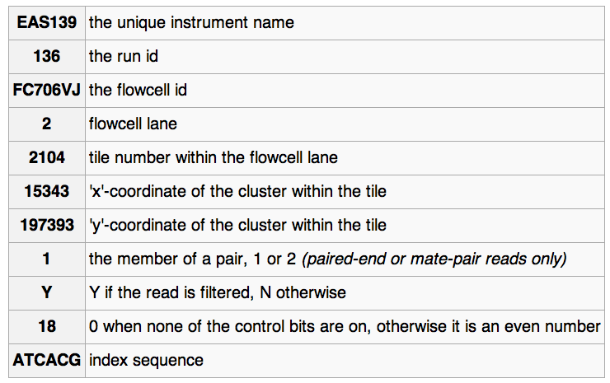
FASTQ read ID variations
@EAS139:136:FC706VJ:2:2104:15343:197393 1:Y:18:ATCACG

Slide 20
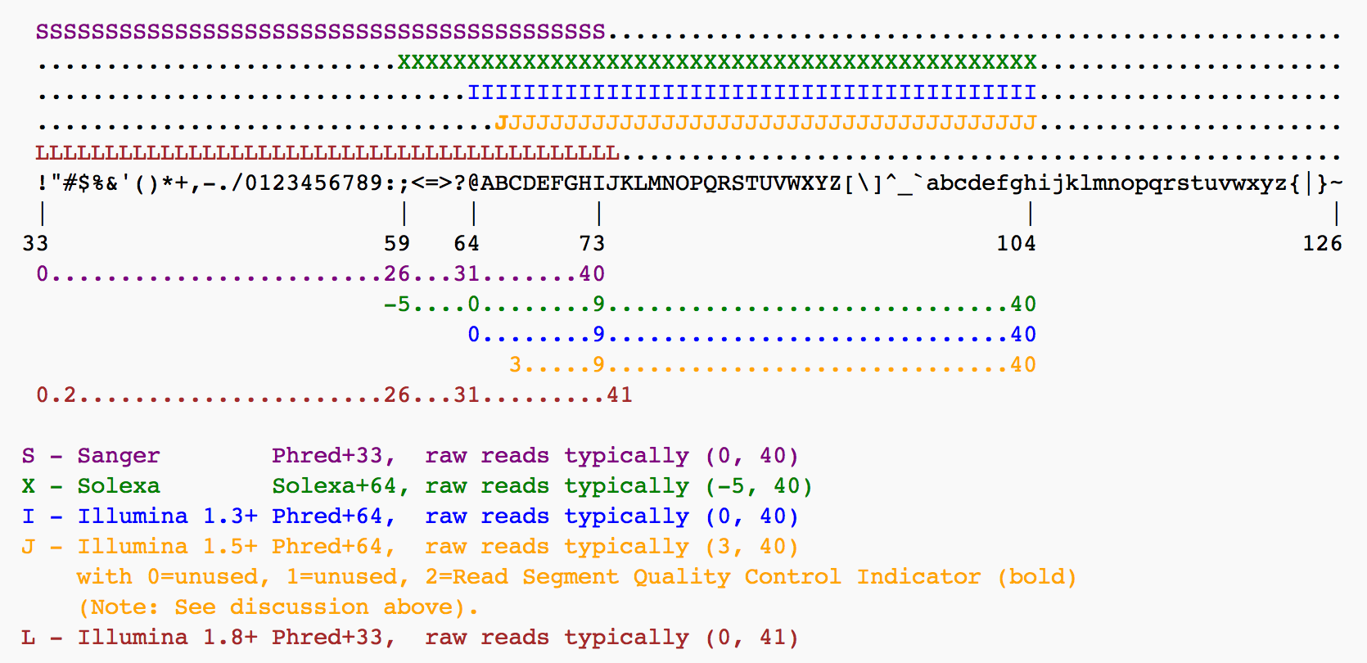
PHRED-like quality
Phred=-10log10(error)

Slide 21
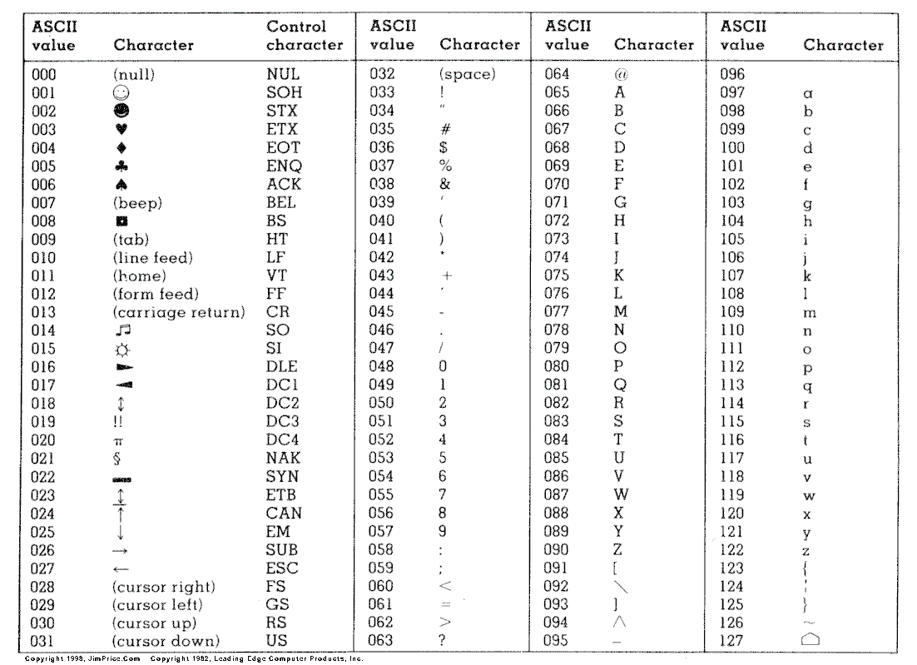
ASCII-Code

Slide 22
FASTQ QC

Slide 23
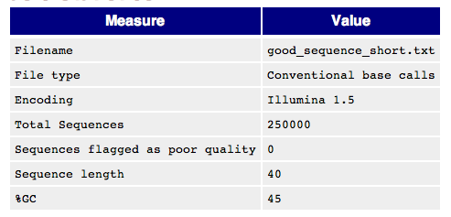
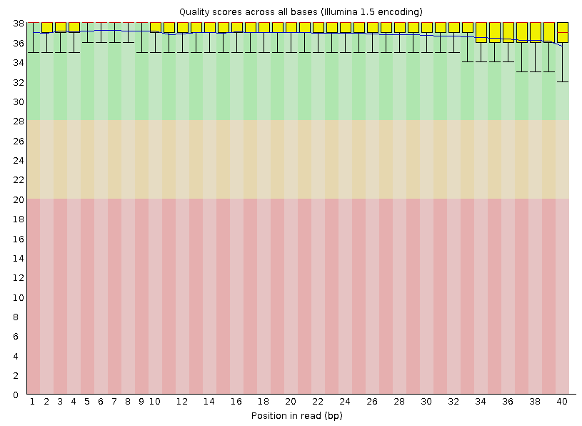
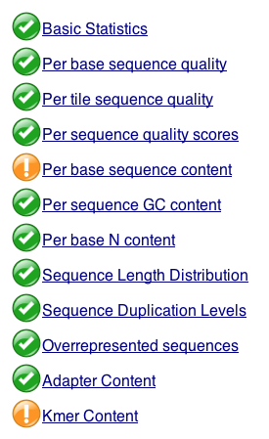
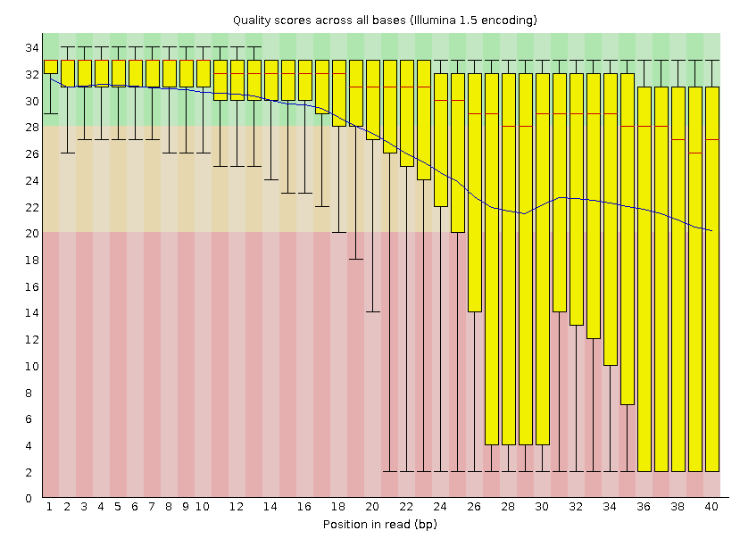
FASTQC
http://www.bioinformatics.babraham.ac.uk/projects/fastqc/

Slide 24
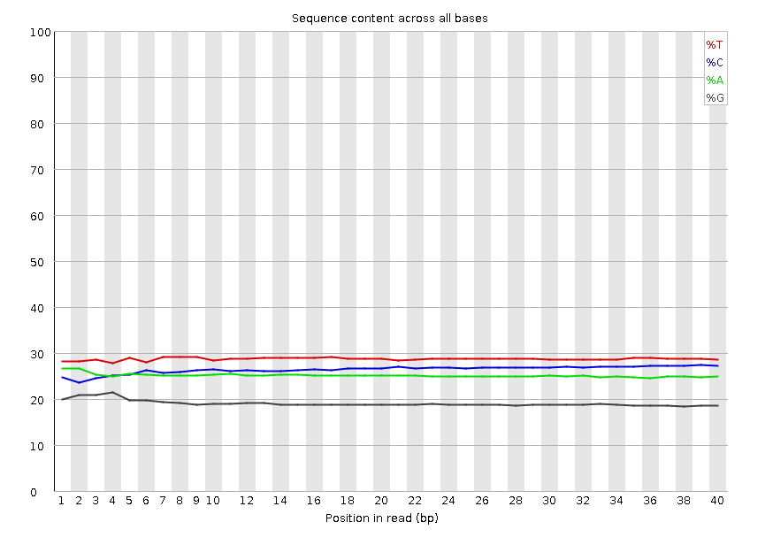
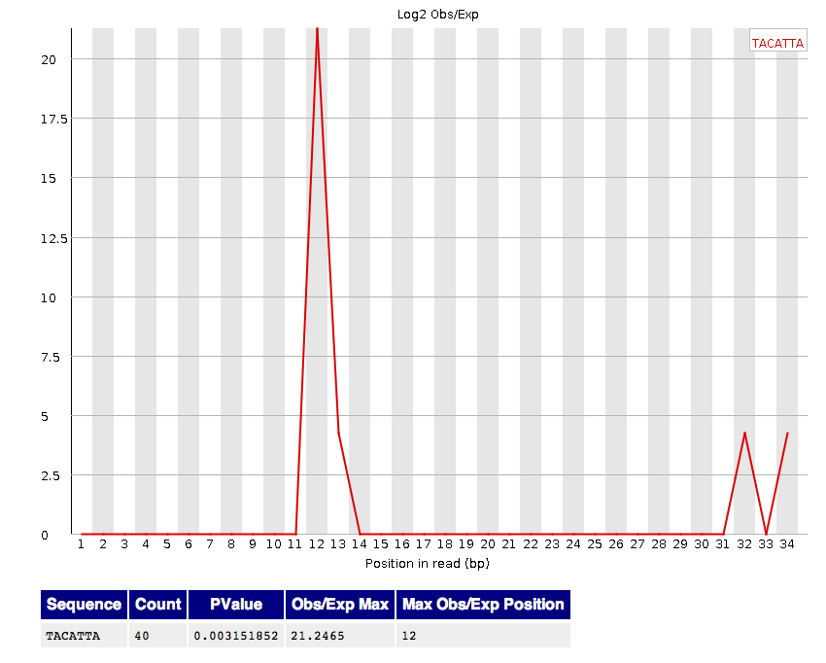
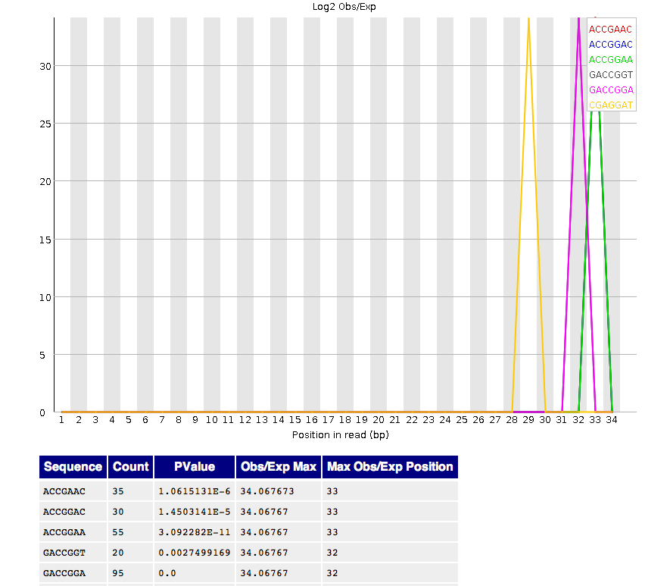
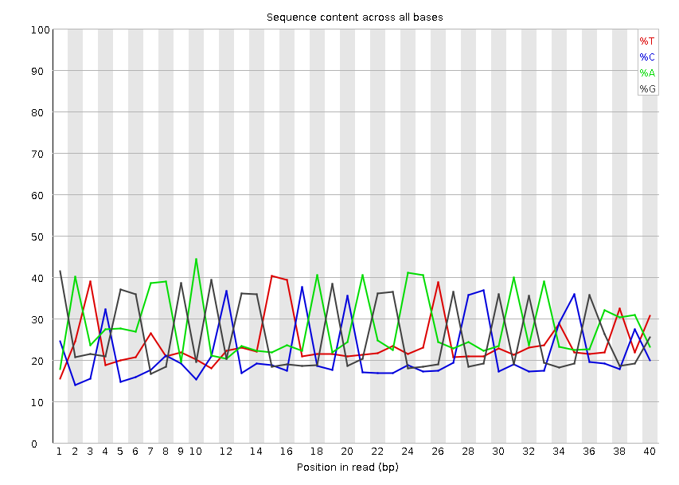
FASTQC Adapter Contamination

Slide 25
Alignment
Using BWA

Slide 26
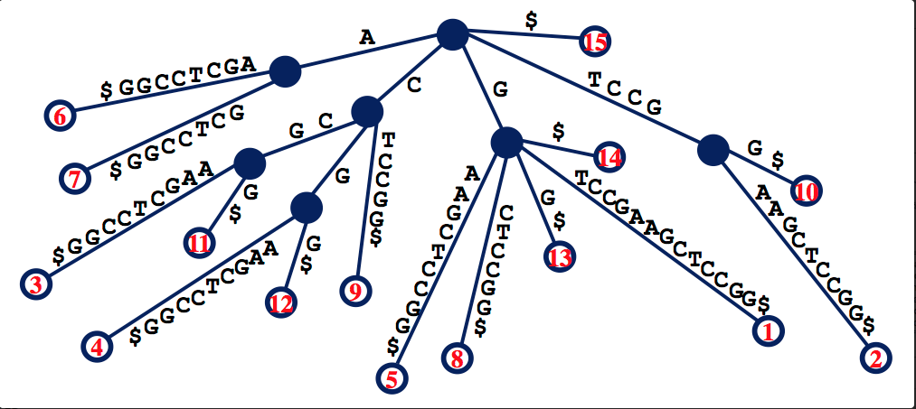
Suffix Array
GTCCGAAGCTCCGG$
Fast but too much memory requirement for the whole genome

Slide 27
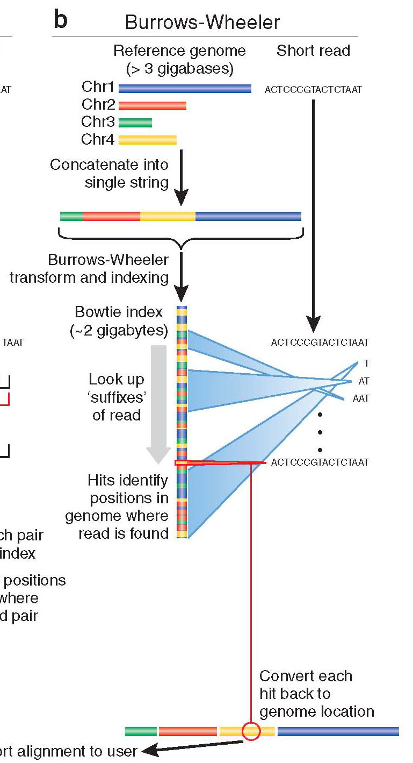
Burrows-Wheeler
Store entire reference genome.
Align tag base by base from the end.
When tag is traversed, all active locations are reported.
If no match is found, then back up and try a substitution.

Slide 28
Burrows-Wheeler Transform (BWT)
BWT
$acaacg
aacg$ac
acaacg$
acg$aca
caacg$a
cg$acaa
g$acaac
acaacg$
gc$aaac

Slide 29
Burrows-Wheeler Matrix
$acaacg
aacg$ac
acaacg$
acg$aca
caacg$a
cg$acaa
g$acaac

Slide 30
Burrows-Wheeler Matrix
3
1
4
2
5
6
$acaacg
aacg$ac
acaacg$
acg$aca
caacg$a
cg$acaa
g$acaac

Slide 31
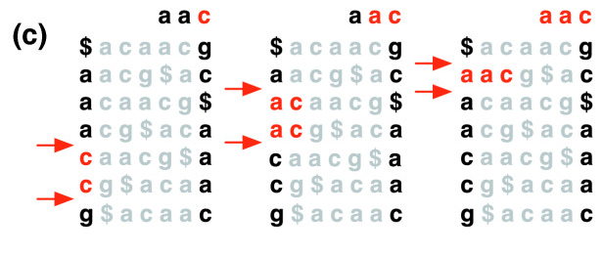
Burrows-Wheeler Transform
Langmead et al (2009)

Slide 32
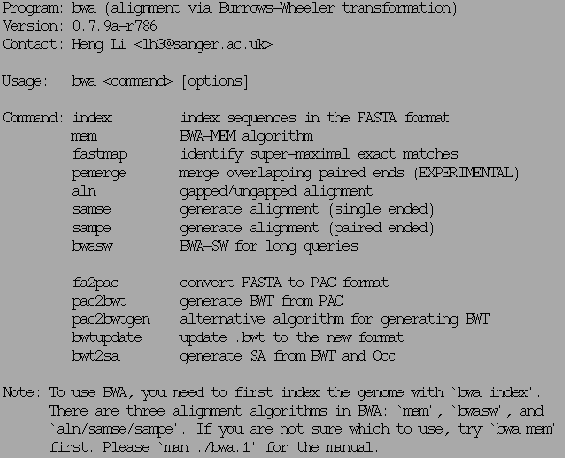
BWA

Slide 33
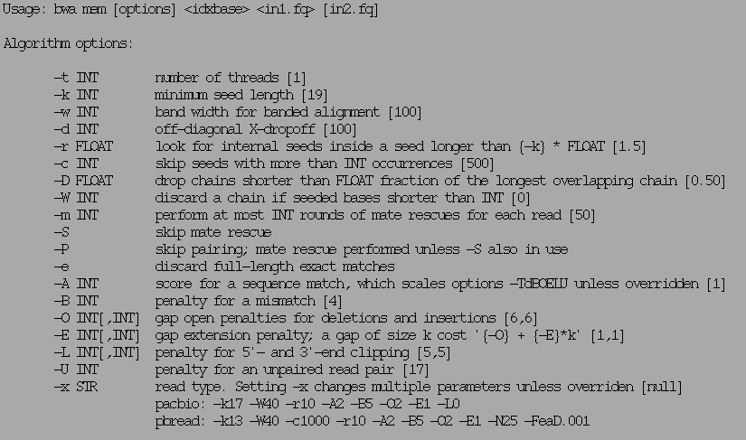
BWA mem

Slide 34
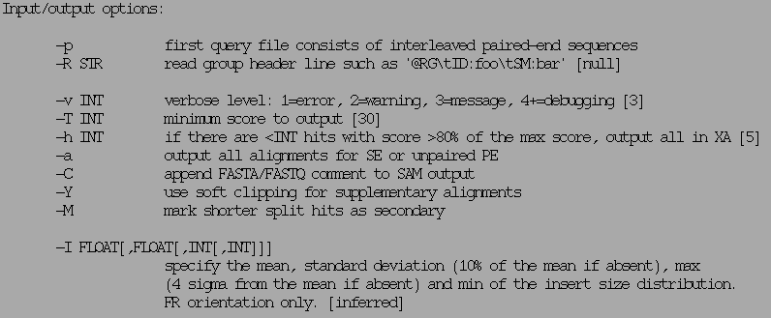
BWA mem

Slide 35
SAM/BAM format

Slide 36
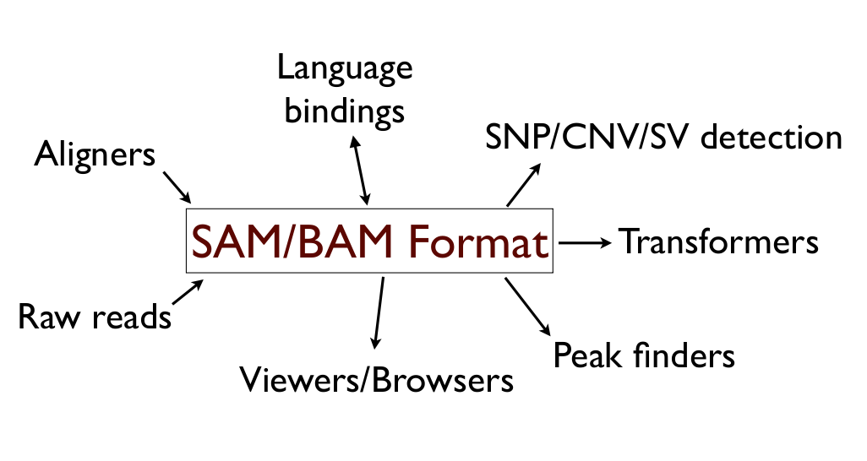
Utility

Slide 37
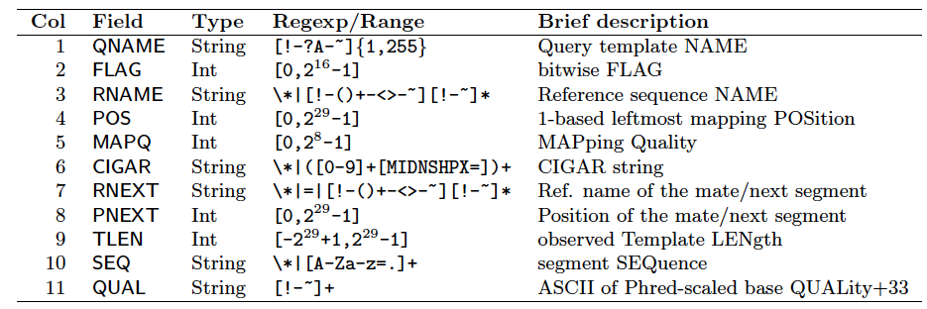
BAM format
Bioinformatics. 2009 Aug 15;25(16):2078-9. Epub 2009 Jun 8. The Sequence Alignment/Map format and SAMtools.

Slide 38
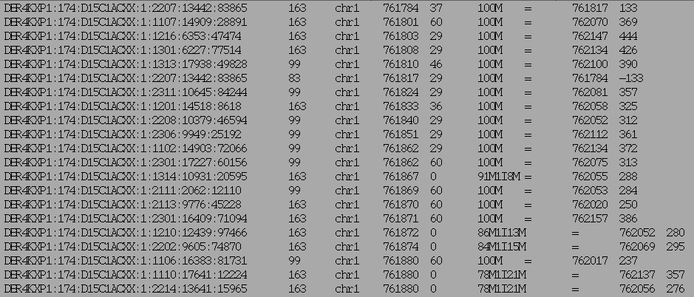
BAM example (field 1-9)

Slide 39
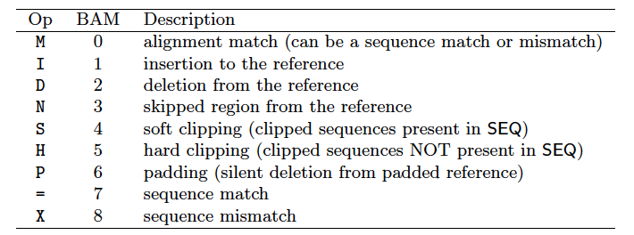
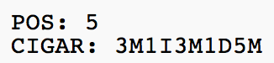
CIGAR string
Before alignment
After alignment

Slide 40
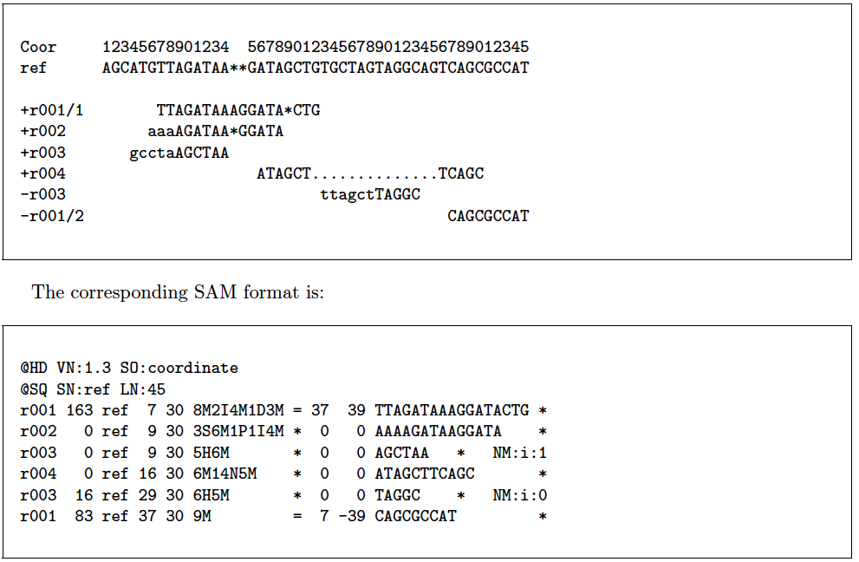
BAM example

Slide 41
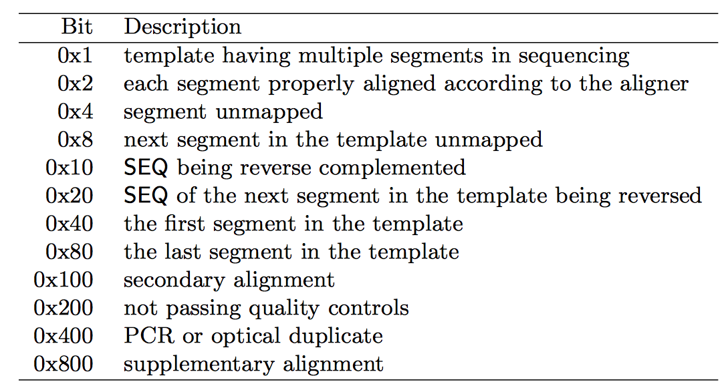
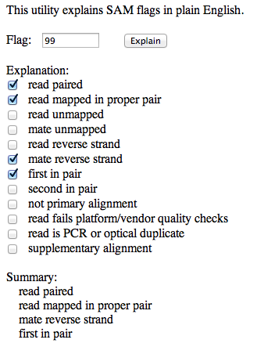
SAM FLAGS
http://picard.sourceforge.net/explain-flags.html

Slide 42
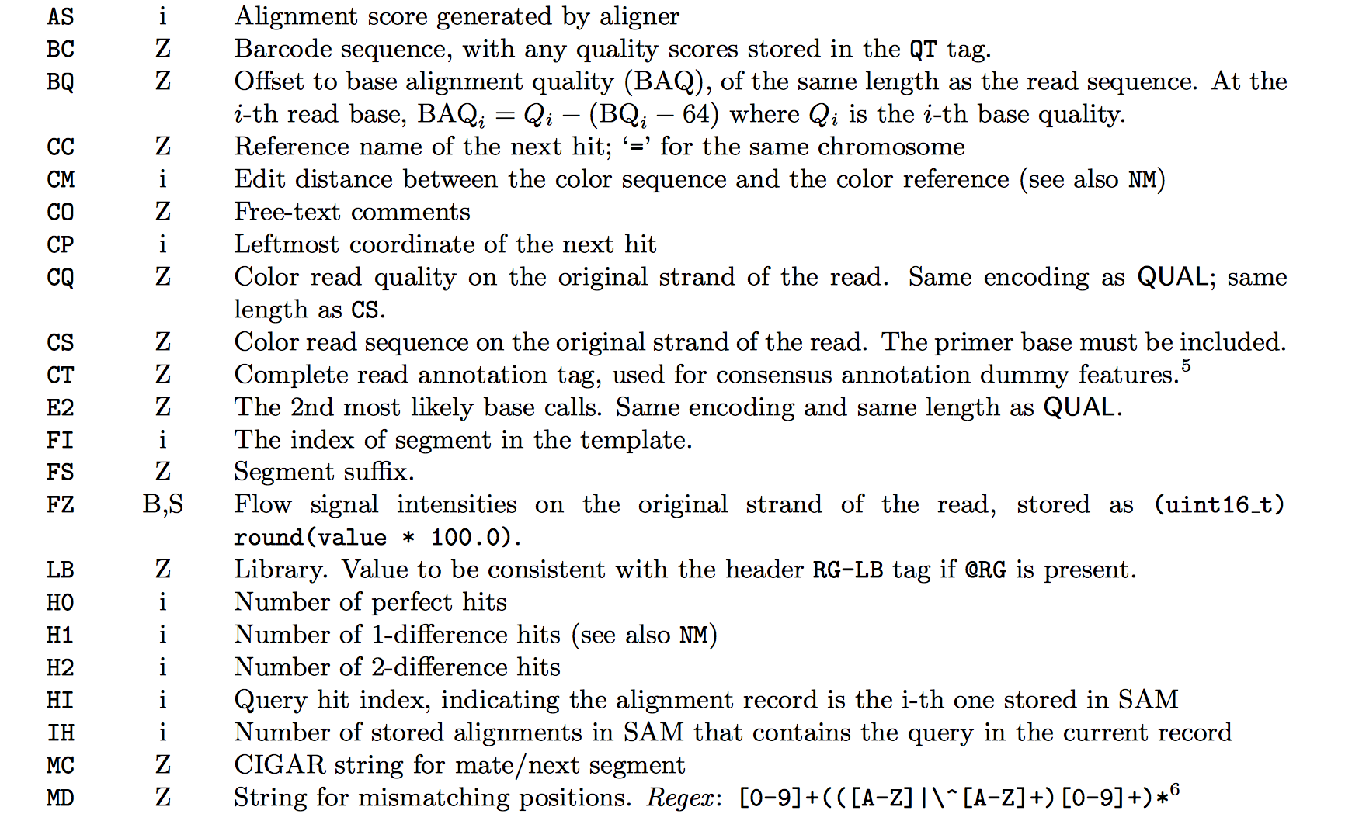
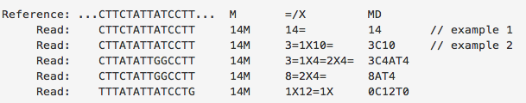
Extra Info (custom)

Slide 43
BAM/SAM format
flexible : compatible with multiple alignment programs
simple: easy to generate and convert
compact in file size
works on a stream : low memory footprint
Indexable for efficiency
SAM is human readable

Slide 44
SAMTOOLS & PICARD
SAM/BAM manipulation

Slide 45
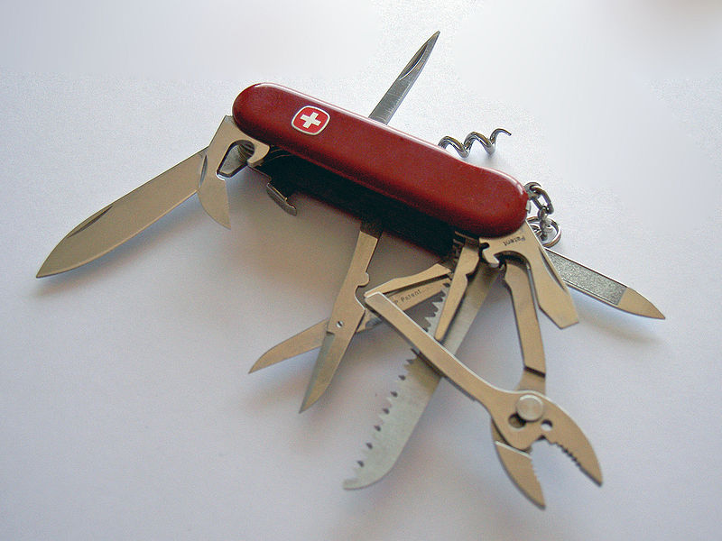

Slide 46
SAMTOOLS
Manipulate alignments in the BAM format
imports from and exports to the SAM (Sequence Alignment/Map) format
sorting
merging
indexing
retrieve reads in any regions
Works on a stream. Commands combined with Unix pipes.
Able to open a BAM on a remote FTP or HTTP server
http://www.htslib.org

Slide 47
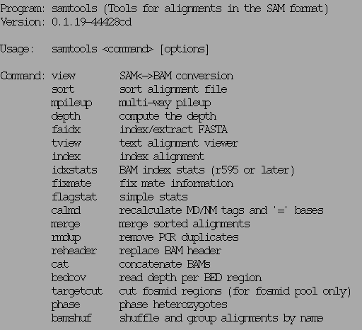
SAMTOOLS examples
http://www.htslib.org

Slide 48
SAMTOOLS view
Usage: samtools view [options] <in.bam>|<in.sam> [region1 [...]]
Options: -b output BAM
-h print header for the SAM output
-H print header only (no alignments)
-S input is SAM
-u uncompressed BAM output (force -b)
-1 fast compression (force -b)
-x output FLAG in HEX (samtools-C specific)
-X output FLAG in string (samtools-C specific)
-c print only the count of matching records
-B collapse the backward CIGAR operation
-@ INT number of BAM compression threads [0]
-L FILE output alignments overlapping the input BED FILE [null]
-t FILE list of reference names and lengths (force -S) [null]
-T FILE reference sequence file (force -S) [null]
-o FILE output file name [stdout]
-R FILE list of read groups to be outputted [null]
-f INT required flag, 0 for unset [0]
-F INT filtering flag, 0 for unset [0]
-q INT minimum mapping quality [0]
-l STR only output reads in library STR [null]
-r STR only output reads in read group STR [null]
-s FLOAT fraction of templates to subsample; integer part as seed [-1]
-? longer help
http://www.htslib.org

Slide 49
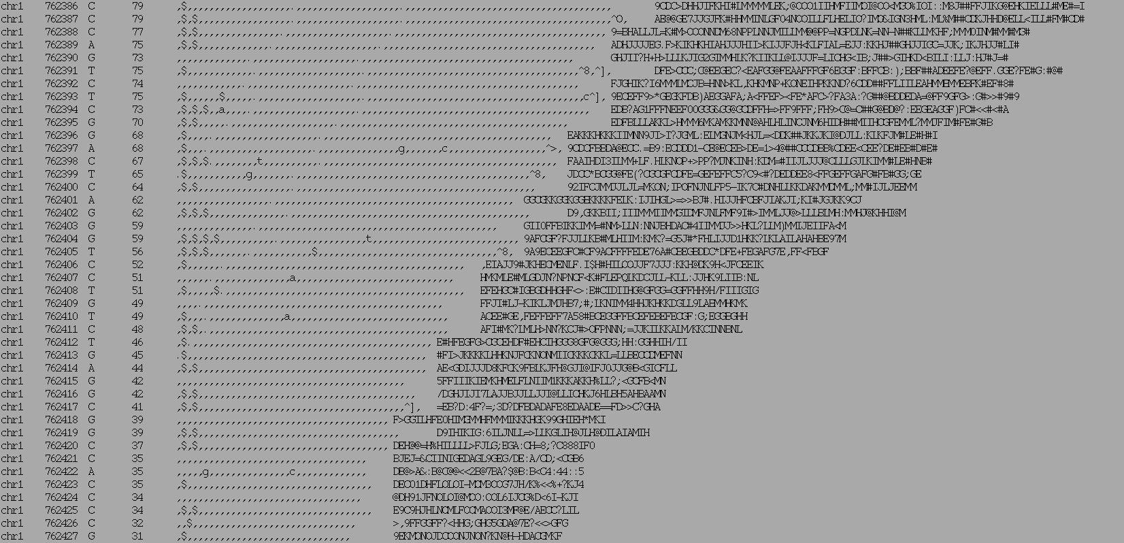
SAMTOOLS Pileup
Chrom
Ref
Read bases
Qualities
Position
Coverage

Slide 50
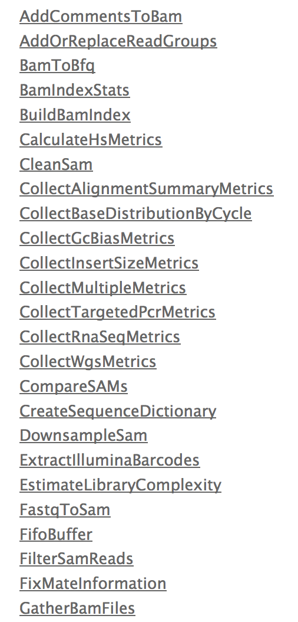
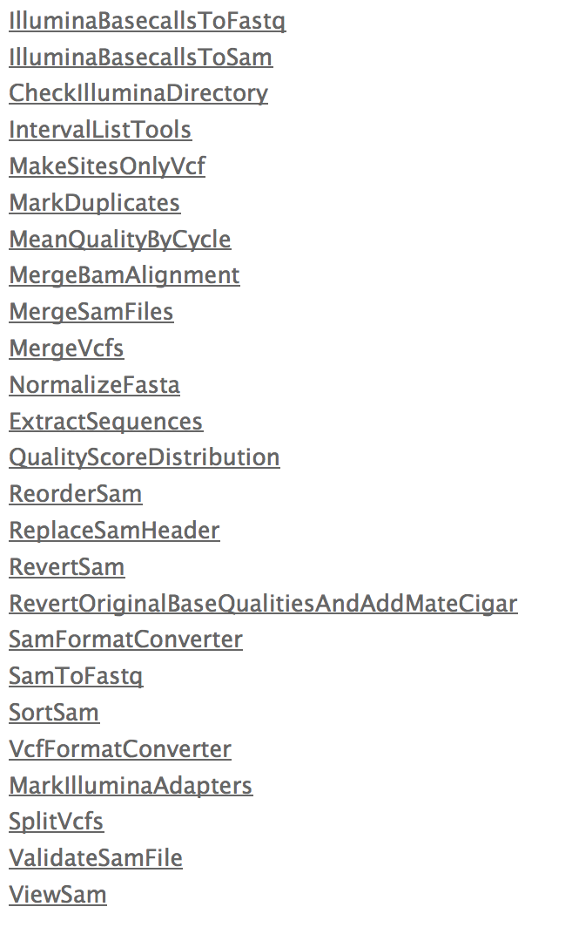
Picard – the other tool box
http://picard.sourceforge.net/

Slide 51
BED and BEDTOOLS
Interval Manipulation

Slide 52
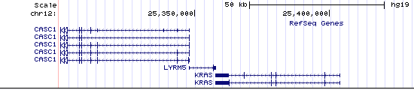
BED track

Slide 53
BED format
Header (space separated) [optional]
Chr [mandatory]
Start [mandatory]
Stop [mandatory]
Other (optional)
Name
Strand
Color
Type
A BAM alignment can be condensed into a BED file: Information loss !

Slide 54
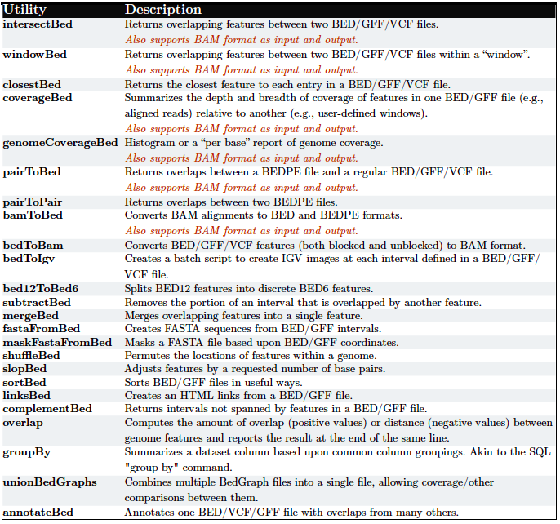
BEDTOOLS

Slide 55
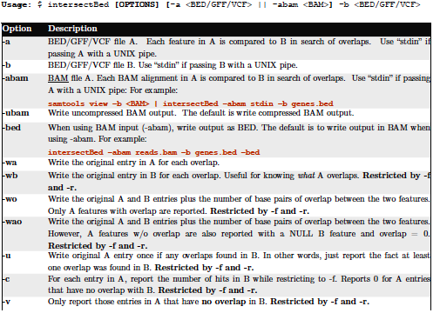
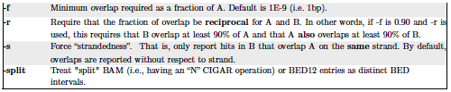
IntersectBed

Slide 56
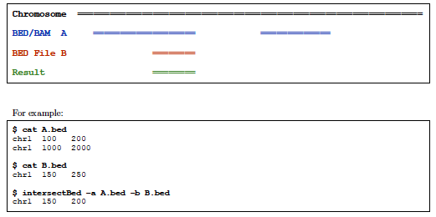
Intersect BED

Slide 57
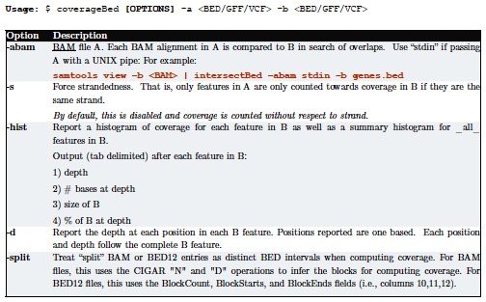
coverageBed

Slide 58
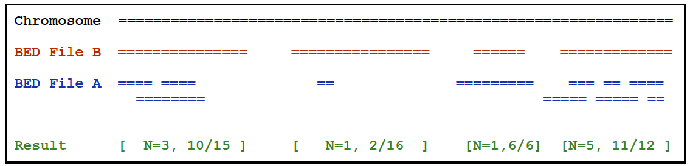


coverageBed

Slide 59

coverageBed

Slide 60
GATK
BAM postprocessing

Slide 61

GATK Best Practice

Slide 62


Slide 63


Slide 64


Slide 65


Slide 66


Slide 67


Slide 68

INDEL Realignment
The problem

Slide 69

INDEL Realignment
The problem

Slide 70

INDEL Realignment
The solution

Slide 71



Base Quality Recalibration
DePristo et al (2011)

Slide 72
ALIGNMENT VISUALISATION

Slide 73

Integrative Genome Viewer
http://www.broadinstitute.org/software/igv/

Slide 74
Integrative Genome Viewer
http://www.broadinstitute.org/software/igv/

Slide 75
Variant Calling
GATK/VARSCAN

Slide 76
Variant Calling
Bayesian Statistics
P(genotype|data)  P(data|genotype).P(genotype)
P(genotype) : prior probability for the genotype
P(data|genotype): likelihood for observed (called) allele
Likelihood P(data|genotype): What’s known to affect base calling:
• Error rate increases as cycle numbers increase
• Error rate depends on substitution type
• Error rate depends on local sequence

Slide 77

GATK Callers

Slide 78

Somatic Variant Calling
Compare Normal and Tumor directly
Results
Germline: Present in both
Somatic: Present in Tumor only
Loss of Heterozygosity: Missed Het in the tumor
Fisher Exact test
Kobolt et al. (2012)

Slide 79

Heuristic Filters

Slide 80
Variant ANALYSIS
VCF / VCFTOOLS

Slide 81

VCF format

Slide 82

VCF format

Slide 83

VCFLib

Slide 84

VCFLib

Slide 85

VCFLib

Slide 86

BCFTOOLS

Slide 87
Variant ANNOTATION

Slide 88
Variant Annotation Tools
SNPEff (Broad)
http://snpeff.sourceforge.net
VEP (Sanger)
http://www.ensembl.org/info/docs/tools/vep/index.html
ANNOVAR
http://www.openbioinformatics.org/annovar/
Variant Tools (database / Manipulation)
http://varianttools.sourceforge.net
McCarty et al: http://genomemedicine.com/content/6/3/26

Slide 89


ANNOVAR
exonic_variant_function

Slide 90

McCarty et al: http://genomemedicine.com/content/6/3/26

Slide 91

Annotation Challenges
Compensating mutations
DNP or TNP need to be annotated together
Phase of Indels on the same haplotype
Partial effects
Mutation affecting one transcript only
Same gene
Unknown Loss of Function mutations affecting known cancer genes
Adapted from MacArthur et al, 2012

Slide 92
Useful Annotations
dbSNP
dbNSFP
SIFT
MutationTaster
COSMIC
ESP data
1000G data
ExAC

Slide 93
Genome BROWSER

Slide 94





Slide 95


Slide 96


Slide 97


Slide 98


Slide 99
Summary and Resources
Formats
FASTQ
SAM/BAM (CRAM)
VCF
Alignment and tools
BWA
IGV
Samtools
Post-Alignment Processing and QC
GATK IndelRealigner
GATK BaseRecalibrator
Picard MarkDuplicate
Picard HS-Metrics
Samtools
Variant Calling
GATK UnifiedGenotyper
GATK HaplotypeCaller
FreeBayes
VarScan (somatic)
Mutect (somatic)
Variant Annotations
SNPEff
ANNOVAR
Vtools
VEP
Intervals and Tracks
UCSC Genome Browser
BEDtools
UNIX

